Slide 1
Lexical Analysis

Slide 2
Outline
• Informal sketch of lexical analysis
– Identifies tokens in input string
• Issues in lexical analysis
– Lookahead
– Ambiguities
• Specifying lexers
– Regular expressions
– Examples of regular expressions

Slide 3
Lexical Analysis
if (i == j)
Z = 0;
else
Z = 1;
• The input is just a string of characters:
\tif (i == j)\n\t\tz = 0;\n\telse\n\t\tz = 1;
• Goal: Partition input string into substrings
– Where the substrings are tokens

Slide 4
What is a Token?
• A syntactic category
– In English:
noun, verb, adjective, …
– In a programming language:
Identifier, Integer, Keyword, Whitespace, …

Slide 5
Tokens
• Tokens correspond to sets of strings.
• Identifier: strings of letters or digits, starting with a letter
• Integer: a non-empty string of digits
• Keyword: “else” or “if” or “begin” or …
• Whitespace: a non-empty sequence of blanks, whitespaces, and tabs

Slide 6
What are Tokens For?
• Classify program substrings according to role
• Output of lexical analysis is a stream of
tokens . . . . . which is input to the parser
• Parser relies on token distinctions
– An identifier is treated differently than a keyword

Slide 7
Designing a Lexical Analyzer: Step 1
• Define a finite set of tokens
– Tokens describe all items of interest
– Choice of tokens depends on language, design of
parser

Slide 8
Example
\t if (i == j)\n\t\tz = 0;\n\telse\n\t\tz = 1;
• Useful tokens for this expression:
Integer, Keyword, Relation, Identifier, Whitespace, (, ), =, ;
(, ), =, ; are tokens, not characters, here

Slide 9
\t → whitespace
If →keyword
( →left paren/(
i →identifier
== →comparison equal
J →identifier
) →right paren/)
\n →whitespace
\t →whitespace
\t →whitespace
Z →identifier
= →assignment/=
0 →integer/number
; →terminal/semicolon
\n →whitespace
\t →whitespace
Else →keyword
\n →whitespace
\t →whitespace
\t →whitespace
Z →identifier
= →assignment/=
1 →integer/number
; →semicolon/;

Slide 10
Designing a Lexical Analyzer: Step 2
• Describe which strings belong to each token
• Recall:
• Identifier: strings of letters or digits, starting with a letter
• Integer: a non-empty string of digits
• Keyword: “else” or “if” or “begin” or …
• Whitespace: a non-empty sequence of blanks, whitespaces, and tabs

Slide 11
Lexical Analyzer: Implementation
• An implementation must do two things:
1. Recognize substrings corresponding to tokens
2. Return the value or lexeme of the token
– The lexeme is the substring

Slide 12
Lexical Analyzer: Implementation
• The lexer usually discards “uninteresting” tokens that don’t contribute to parsing.
• Examples: Whitespace, Comments

Slide 13
Lexical Analysis in FORTRAN
• FORTRAN rule: Whitespace is insignificant
• E.g., VAR1 is the same as VA R1

Slide 14
Example
• Consider
DO 5 I = 1,25
DO 5 I = 1.25

Slide 15
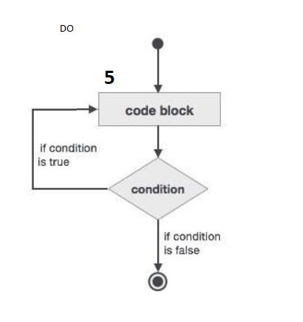
Example
• Consider
DO 5 I = 1,25
DO 5 I = 1.25
DO 5
--------
--------
--------
5

Slide 16
Lexical Analysis in FORTRAN (Cont.)
• Two important points:
1. The goal is to partition the string. This is
implemented by reading left-to-right, recognizing one token at a time
2. “Look ahead” may be required to decide where one token ends and the next token begins

Slide 17
Lookahead
• Even our simple example has lookahead issues
– i vs. if
– = vs. ==
• Footnote: FORTRAN Whitespace rule motivated by inaccuracy of punch card operators

Slide 18
Lexical Analysis in PL/I
• PL/I keywords are not reserved
IF ELSE THEN THEN = ELSE; ELSE ELSE = THEN

Slide 19
Lexical Analysis in PL/I
• PL/I keywords are not reserved
IF ELSE THEN THEN = ELSE; ELSE ELSE = THEN
IF (Condition)
THEN statement
ELSE statement

Slide 20
Lexical Analysis in PL/I
IF → Key word
ELSE → Identifier
THEN →Key word
THEN →Identifier
= → Assignment/=
ELSE →Identifier
; → Terminal/ semicolon
ELSE →Key word
ELSE →Identifier
= → Assignment/=
THEN →Identifier

Slide 21
Lexical Analysis in C++
• Unfortunately, the problems continue today
• C++ template syntax:
Foo<Bar>
• C++ stream syntax:
cin >> var;
• But there is a conflict with nested templates:
Foo<Bar<Bazz>>

Slide 22
The goal of lexical analysis is to
– Partition the input string into lexemes
– Identify the token of each lexeme
• Left-to-right scan => lookahead sometimes
required

Slide 23
We still need
– A way to describe the lexemes of each token
– A way to resolve ambiguities
• Is if two variables i and f?
• Is == two equal signs = =?

Slide 24
Regular Languages
• There are several formalisms for specifying
tokens
• Regular languages are the most popular
– Simple and useful theory
– Easy to understand
– Efficient implementations

Slide 25
Languages
Let ∑ be a set of characters.
A language over ∑ is a set of strings of characters drawn from ∑

Slide 26
Examples of Languages
• Alphabet = English
characters
• Language = English
sentences
• Not every string of
English characters is an
English sentence
• Alphabet = ASCII
• Language = C programs
• Note: ASCII character
set is different from
English character set

Slide 27
Notation
• Languages are sets of strings.
• Need some notation for specifying which sets we want
• The standard notation for regular languages is regular expressions.

Slide 28
Atomic Regular Expressions
• Single character
• Epsilon
'c ' ={"c"}
ε = {""}

Slide 29
Compound Regular Expressions
• Union
• Concatenation
• Iteration

Slide 30
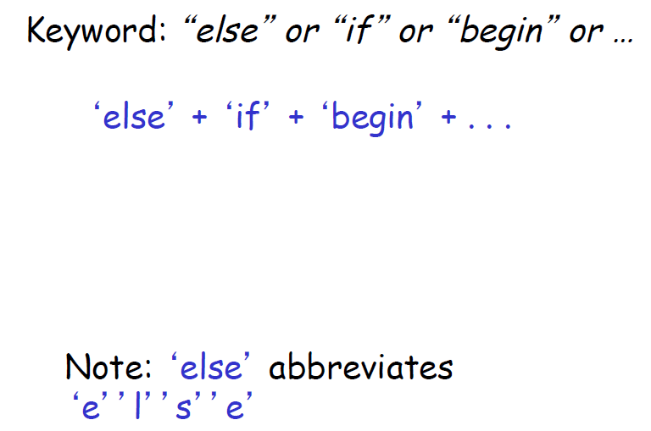
Example: Keyword

Slide 31
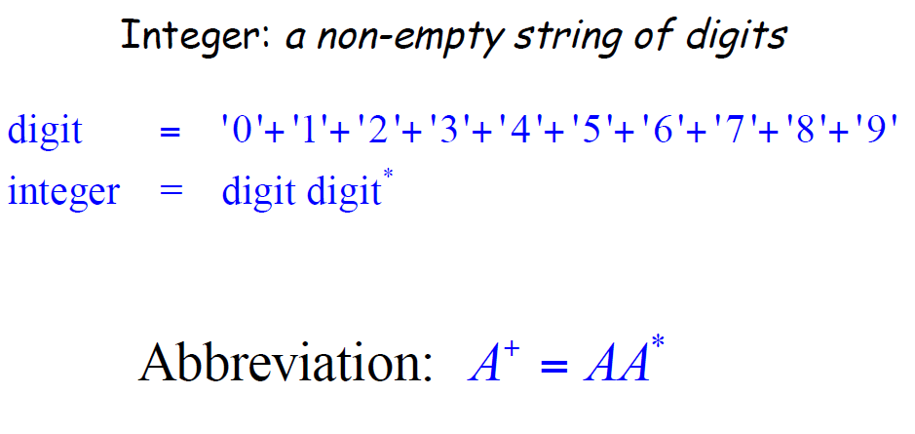
Example: Integers

Slide 32
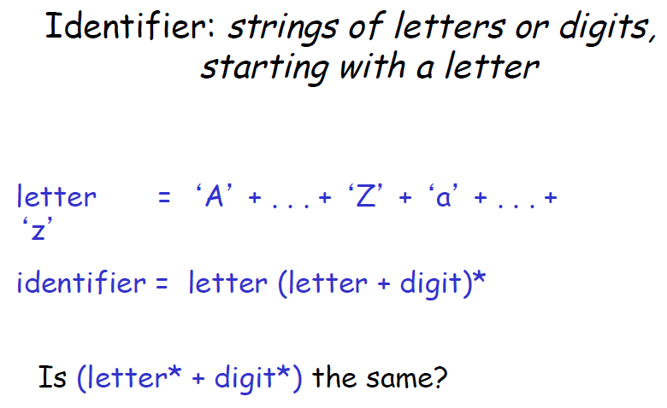
Example: Identifier

Slide 33
Example: Whitespace
Whitespace: a non-empty sequence of blanks, whitespaces, and tabs
(' ' + '\n' + '\t‘)⁺

Slide 34
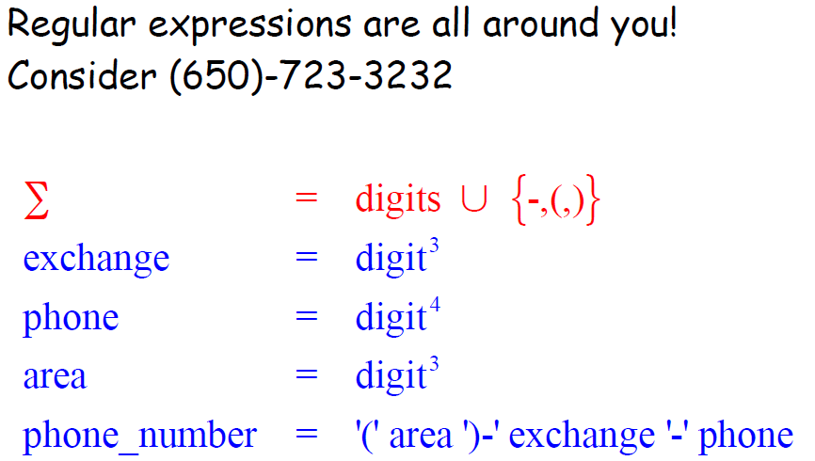
Example: Phone Numbers

Slide 35
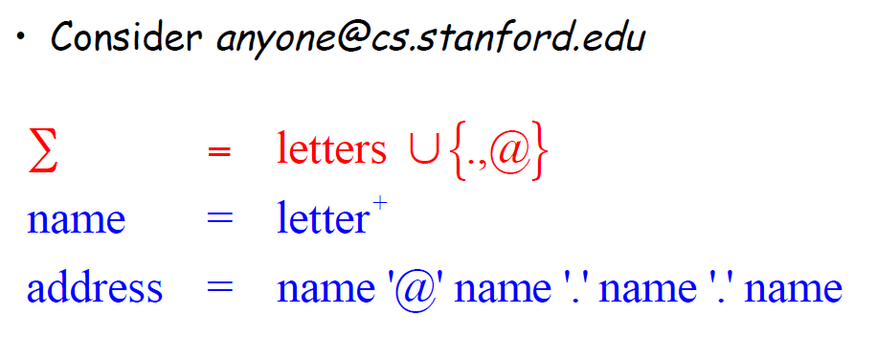
Example: Email Addresses

Slide 36
Example: Unsigned Pascal Numbers
digit = '0' +'1'+'2'+'3'+'4'+'5'+'6'+'7'+'8'+'9'
digits = digit ⁺
opt_fraction = ('.' digits) + ε
opt_exponent = ('E' ('+' + '-' + ε ) digits) + ε
num = digits opt_fraction opt_exponent

